Slide 1
Numerical Analysis of Chaos in Lagrangian Systems
Jessie Wu
Ph 235
Spring 2017

Slide 2
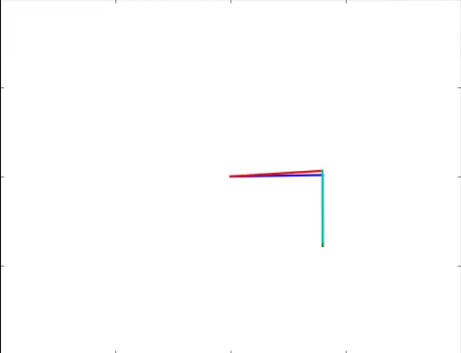
Chaos
Behavior of deterministic systems that are highly sensitive to initial conditions
Double Pendulums are a classic example
Notes:
Chaos: infinitesimal (extremely small) difference in initial conditions lead to large differences in state in small amount of time
Errors grow exponentially in time

Slide 3
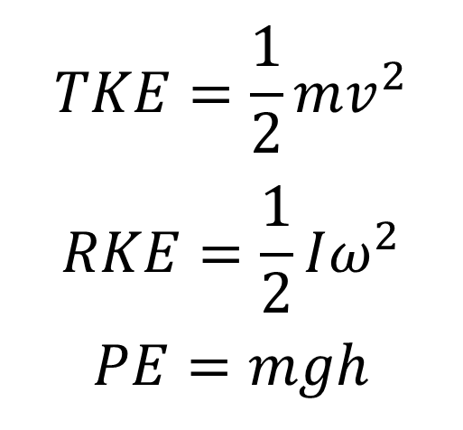
Problem Statement
Characterize the dynamics of this specific triple pendulum
$$TKE=\frac{1}{2}mv^{2}$$
$$RKE=\frac{1}{2}Iω^{2}$$
$$PE=mgh$$
Gravity, m/s² | 9.8
Length, m | 0.4
Mass, kg | 1.0

Slide 4
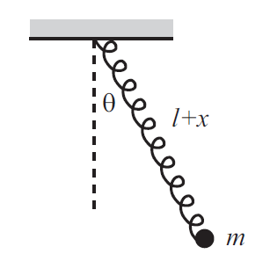
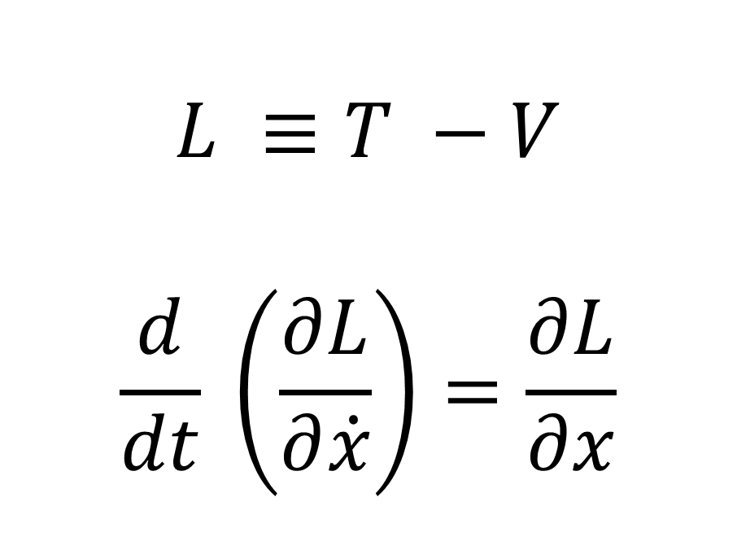
Lagrangian Method
Case Study: Pendulum Spring
$$L ≡T −V$$
$$\frac{d}{dt} \left(\frac{∂L}{∂\dot{x}}\right)=\frac{∂L}{∂x}$$

Slide 5
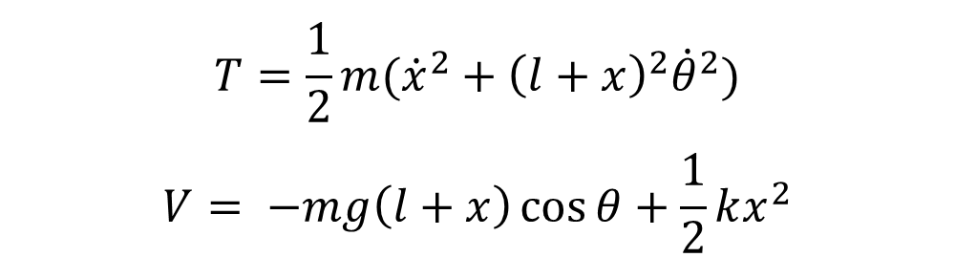
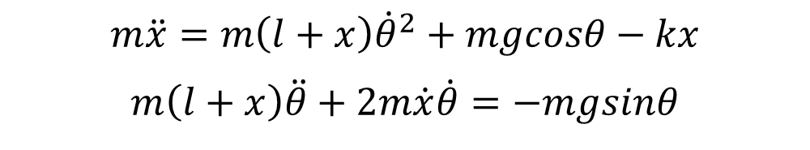
Lagrangian Method
$$T=\frac{1}{2}m({\dot{x}}^{2}+{\left(l+x\right)}^{2}{\dot{θ}}^{2})$$
$$V= −mg\left(l+x\right)\cos{θ}+\frac{1}{2}kx^{2}$$
Take Derivatives
$$m\ddot{x}=m\left(l+x\right){\dot{θ}}^{2}+mgcosθ−kx$$
$$m\left(l+x\right)\ddot{θ}+2m\dot{x}\dot{θ}=−mgsinθ$$

Slide 6
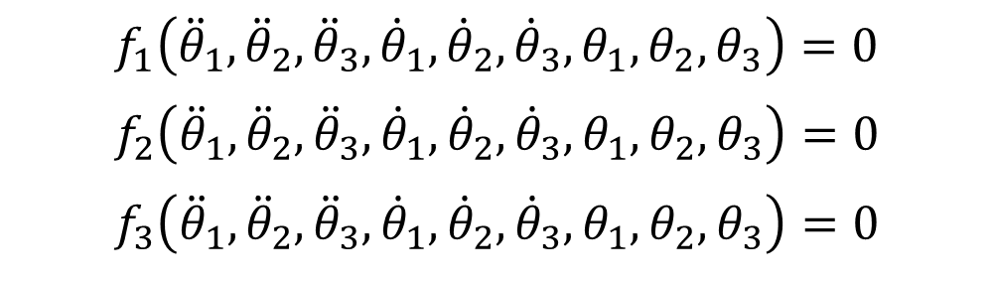


Runge Kutta 4th Order Algorithm
$$f_{1}\left({\ddot{θ}}_{1},{\ddot{θ}}_{2},{\ddot{θ}}_{3},{\dot{θ}}_{1},{\dot{θ}}_{2},{\dot{θ}}_{3},θ_{1},θ_{2},θ_{3}\right)=0$$
$$f_{2}\left({\ddot{θ}}_{1},{\ddot{θ}}_{2},{\ddot{θ}}_{3},{\dot{θ}}_{1},{\dot{θ}}_{2},{\dot{θ}}_{3},θ_{1},θ_{2},θ_{3}\right)=0$$
$$f_{3}\left({\ddot{θ}}_{1},{\ddot{θ}}_{2},{\ddot{θ}}_{3},{\dot{θ}}_{1},{\dot{θ}}_{2},{\dot{θ}}_{3},θ_{1},θ_{2},θ_{3}\right)=0$$
. . .
$$y_{1}= {\dot{θ}}_{1}$$
$$y_{2}= {\dot{θ}}_{2}$$
$$y_{3}= {\dot{θ}}_{3}$$
$$\dot{y_{1}}=f(y_{1},θ)$$
$$\dot{y_{2}}=f(y_{2},θ)$$
$$\dot{y_{3}}=f(y_{3},θ)$$

Slide 7

Animation and Plot

Slide 8
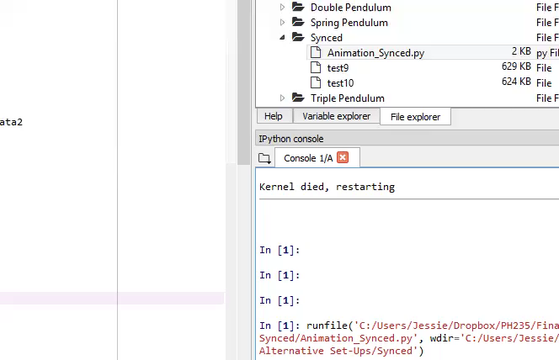
Animation and Plot

Slide 9
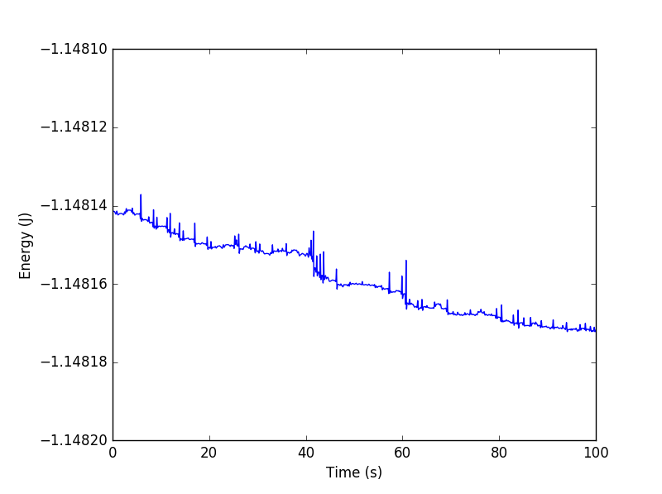
Animation and Plot
Energy Over Time (Joules)
Max Difference: 3.5e-05

Slide 10
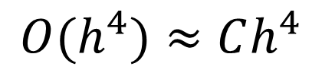
Checking for Error
$$O(h^{4})≈Ch^{4}$$

Slide 11
Lyapunov Exponent

Slide 12
Solution Process
Determine Constants and Langrangian (Energy)
Take Derivatives to Find Equations of Motion
Run RK4 Algorithm to Determine Numerical Solution
Convert from Angles to Coordinates
Plot and Animate Results

Slide 13
Solution Process
Determine Constants and Langrangian (Energy)
Take Derivatives to Find Equations of Motion
Run RK4 Algorithm to Determine Numerical Solution
Convert from Angles to Coordinates
Plot and Animate Results

Slide 14

Additional Systems

Slide 15

Additional Systems

Slide 16
Questions?

Slide 18
Notes From Wolf
Chaos: infinitesimal (extremely small) difference in initial conditions lead to large differences in state in small amount of time
Errors grow exponentially in time
Demo butterfly effect
Specify that this is a specific configuration for a triple pendulum
For Lagrangian, show an example
Show table of step sizes, and accuracy by factors of 16
Show “constant” total energy, as a function of h
Calculate Lyapanov exponent, make sure you have data from long enough

